Slide 2
Getting started with machine learning & data science for security
SEC351-R
Neal J. Rothleder
Jeff Puchalski
Practice Manager / Sr. Consultant
AWS Professional Services
Amazon Web Services
Sr. Security Engineer
AWS Security
Amazon Web Services

Slide 3
Objectives
What types of security problems lend themselves to ML & data science?
What are some ways to get started?
Which data?
How to explore?
Can I really build an ML model?
How do I use the model after it is built?

Slide 4
Agenda
Introductions
Machine learning, data science, and security
Characterizing the use cases
Demonstrations
Conversation, conversation, conversation
Notes:
We only have an hour. Not intending to spend much time on explaining the basic concepts of Security, ML, Data Science.
MOST IMPORTANTLY:
Value of a small group discussion is we can go where you’d like.
** Feel free to ask or raise an idea. **
Don’t want to wander too far off topic, and want to be respectful of the full group.

Slide 5
Related breakouts
SEC351-R1 – Getting started with machine learning & data science for security
Wednesday, Dec 4, 11:30 AM - 12:30 PM – Mirage, Events Center C1 - Table 8
SEC351-R2 – Getting started with machine learning & data science for security
Wednesday, Dec 4, 5:30 PM - Aria, Level 1 West, Bristlecone 2 - Table 6
SEC351-R3 – Getting started with machine learning & data science for security
Thursday, Dec 5, 12:15 PM - Aria, Level 1 West, Bristlecone 4 - Table 7

Slide 6
Introductions
Notes:
Me.
You. Very briefly, 20 seconds. Your name, your role, and your organization if you’re comfortable sharing that

Slide 7
“…the domain of cybersecurity is characterized by weak signals, intelligent actors, a large attack surface, and a huge number of variables.”
Simon Crosby
Founder, Bromium
Notes:
The big challenge of looking at data in cyber security
(Worth noting that Dr. Crosby was being _critical_ of the use of ML in this context. He was arguing that we can’t automate the solution.)
I agree that we cannot fully automate the solution. We cannot hand this off to machines. However, I continue to believe that where there are critical tasks that require humans to sift through and manipulate mountains of data, ML and Data Science – while not a magic bullet – can help prune, sort, filter, and highlight things so humans can use their time more efficiently.

Slide 8
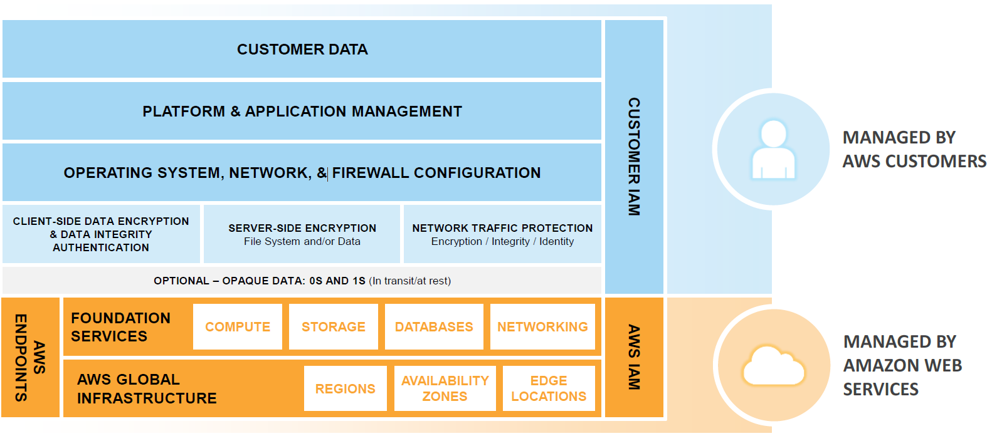
AWS shared responsibility model
Customer data
Platform & application management
Customer IAM
Security in the cloud
Operating system, network, & firewall configuration
Client-side data encryption & data integrity authentication
Server-side encryption
File system and/or data
Network traffic protection
Encryption/Integrity/Identity
Optional – opaque data: 0s and 1s (in transit and at rest)
Foundation
services
Compute
Storage
Databases
Networking
Security of the cloud
AWS endpoints
AWS IAM
AWS global
Infrastructure
Regions
Availability Zones
Edge locations
Notes:
{{BRIEFLY}}
Want to remind folks of key elements of AWS Security:
1. Shared Responsibility Model – key concept

Slide 9
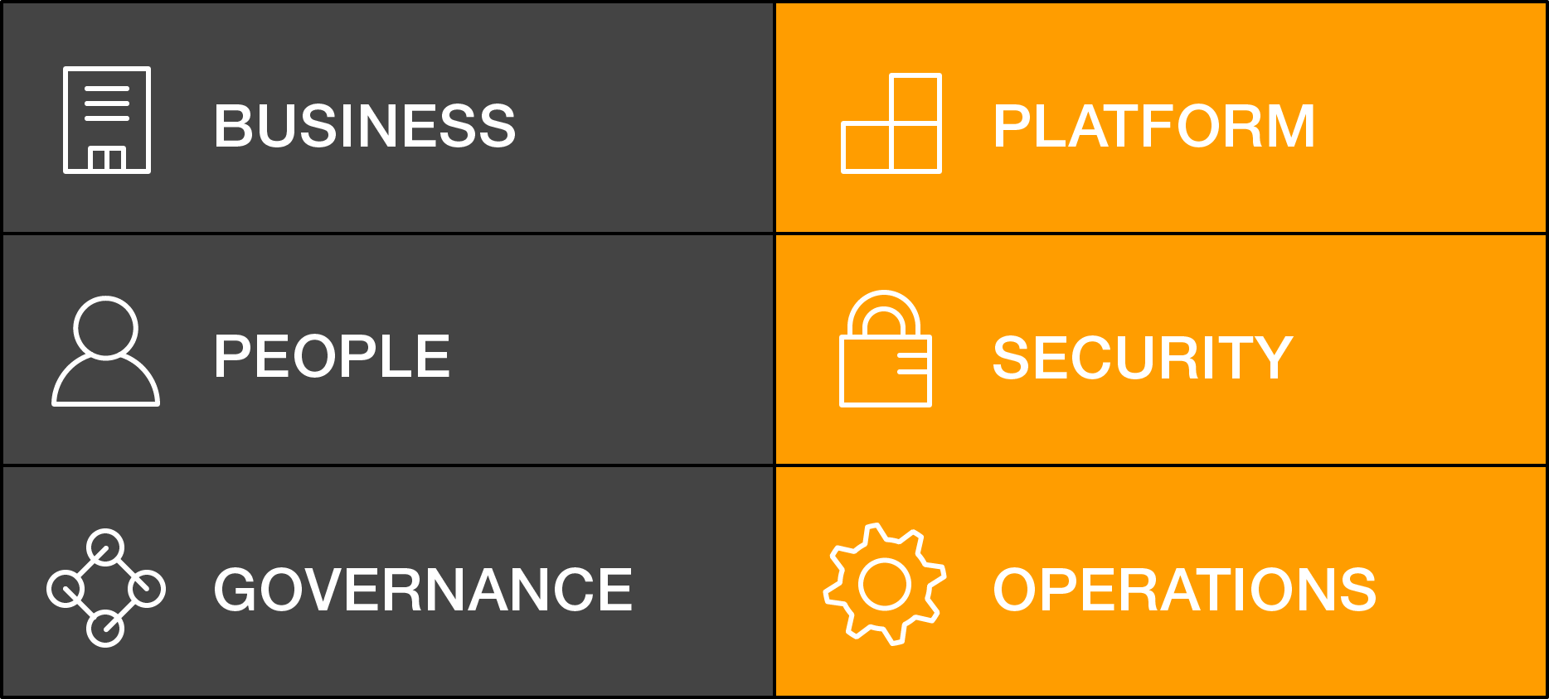
AWS Cloud Adoption Framework, security perspective
Security perspective
Directive
Preventative
Detective
Responsive
Notes:
{{BRIEFLY…}}
2. CAF and the security perspective – the four types of controls.
Our demos today really focus on Detective Controls – how develop “sensors” that I can use to monitor my environment and identify findings of interest in some automated way.

Slide 10





The security capabilities
Identity
Detective control
Infrastructure security
Data protection
Incident response
Control systems access
Gain visibility
Protect your cloud infra
Encrypt your data
Respond swiftly
Notes:
{{Hidden}}
Quick overview of how we think about security on AWS: The five key security capabilities for the security perspective.
There are an additional 5 capabilities, one of which is Big Data and Machine Learning for Security.

Slide 11
Machine learning and data science
Data processing & analytics
Computer science
Machine learning
Data science
Subject matter expertise
Mathematics
Notes:
What we mean by “Data Science” and “Machine Learning” – just an abstract view. Not the same thing. Don’t want to get into any religious wars. Just an overview.
Generally, speaking, ML is that subset of AI that focuses on the mechanisms, algorithms, and techniques for getting machines to learn.
Data Science is the more applied practice of techniques to explore data and find useful patterns in it. In Data Science, understand the domain is critical.
{fyi: the intersection of ”Mathematics” and “Subject Matter Expertise” is Statistical Analysis. Just didn’t want to squeeze more words on the slide.}

Slide 12
Types of machine learning
Machine learning
Supervised
Unsupervised
Reinforcement
Notes:
Types of Machine Learning – a simplified view Don’t want to get into any religious wars. Just an overview.
Supervised – Classification, Regression, Often called “task driven”, requires some type of “labelling” the data in independent and dependent variables
Unsupervised – Clustering, anomaly detection, often called “data driven”, used to “discover” structure or latent variables in data
Reinforcement – instead of predetermined data, agent operates in an environment to, collecting feedback (reward), to learn appropriate actions to optimize a task
We’re going to focus on two approaches today – Time series (which is considered supervised) and Anomaly Detection, which is generally done in an unsupervised way.

Slide 13
Machine learning—supervised
?
?
?
Notes:
{{Hidden Slide}}
Supervised – Classification, Regression, Often called “task driven”, requires some type of “labelling” the data in independent and dependent variables

Slide 14
Machine learning—unsupervised
?
Notes:
{{Hidden Slide}}
Unsupervised – Clustering, anomaly detection, often called “data driven”, used to “discover” structure or latent variables in data

Slide 15
Machine learning—reinforcement learning
State
Agent
Reward
Observation
Action
Environment
Notes:
{{Hidden slide}}
* Reinforcement – instead of predetermined data, agent operates in an environment to, collecting feedback (reward), to learn appropriate actions to optimize a task
* Reinforcement Learning(RL) is a type of machine learning technique that enables an agent to learn in an interactive environment by trial and error using feedback from its own actions and experiences.
Though both supervised and reinforcement learning use mapping between input and output, unlike supervised learning where feedback provided to the agent is correct set of actions for performing a task, reinforcement learning uses rewards and punishment as signals for positive and negative behavior.
As compared to unsupervised learning, reinforcement learning is different in terms of goals. While the goal in unsupervised learning is to find similarities and differences between data points, in reinforcement learning the goal is to find a suitable action model that would maximize the total cumulative reward of the agent.

Slide 16


Some ML & data science security topics
Bot detection
Spot malicious reconnaissance
Exfiltration identification and prevention
Data classification
Characterizing insider threat
Malware identification
Respond to credential theft/impersonation
Network behavior analysis
Amazon GuardDuty
Amazon Macie
Notes:
Some types of situations for ML/Data Science & Security
Talk to a few of these examples…
Bot detection – might look for beacon behavior
Data classification – mix of regex and supervised labelling (often use text/word analyzers)
Malware identification – lots of work here in endpoint protection – more and more sharing of malware samples. One key is choosing the right features. Arms race. (CAMLIS)
Insider threat – often involves profiling ”normal” or “typical” user behavior. We’re going to look at one variation of this.
Talk about role of GuardDuty and Macie – where they focus
We’re going to dive deeper into two use cases today – around credential theft and Insider threat

Slide 17
Characterizing the use case

Slide 18
Key characteristics
What is the security challenge & outcome?
What action will be taken?
Is there already a hypothesis you can check?
Response time: Exploration… batch… (near) real time?
Notes:
Notice – these are business/security questions. Nothing here about the algorithms, representations (graph, relational), the data, training epochs, etc.

Slide 19
Today’s scenario 1: Anomalous IP usage
Identify users accessing our AWS account from an unusual IP address
For every user, provide a score for “unusual”
Action: Each GuardDuty finding will be scored this way and the information will be added in our SIEM
Hypothesis: Other than recording each IP address used and checking that list… need a method
Response: (Near) real time

Slide 20
Today’s scenario 2: Monitoring automated roles
Identify roles likely doing automated tasks, and identify when that role appears to be doing something “different”
For a tuple [User, AWS API call, Date/Time]—provide a score for how unusual it is
Action: Each selected <user, API call> pair will be scored this way and the information will be added in our SIEM
Hypothesis: Automation roles should make the same API calls repeatedly in a pattern. Identify those and monitor for a break in the pattern.
Response: Exploration, and then batch

Slide 21





Tools we’ll use today
AWS CloudTrail
Amazon Athena
AWS Lambda
Amazon SageMaker
Jupyter notebooks (Python, training, inference endpoints)
Algorithms: IPInsights, Custom LSTM time series prediction
Amazon Simple Storage Service (Amazon S3)
SQL, Python

Slide 22
Configuration, tuning, and tailoring
Data: Size, split, format, precision, real, synthetic…
Algorithm: Which, approach, output type, bias, interpretability…
Hyperparameters!
https://docs.aws.amazon.com/sagemaker/latest/dg/xgboost_hyperparameters.html
The “art” of data science
Notes:
Two important points:
ML & Data Science don’t generally produce ready-to-deploy models on the first pass (or the second pass)… There’s lots of experimentation, configuration, and tuning that goes on. It’s all very custom and nees to be tailored to your particular use case and environment. That’s the art here.
Example of IPInsights for a consumer-facing use case vs. for an employee-only access a single app
* As we’ve said, we’re in “getting started” mode. The examples we’re showing do not include all this tuning and optimization. We want give you the basic to start exploring the data, building that first model and seeing how it does – what might work well and what you might tune.

Slide 23
Deploying
Exploration—Proactive investigation
Batch—Collecting data real-time, but processing on some interval (e.g., hourly, daily)
Near real time—Monitor activity continuously for indicators
Notes:
This is all about trade-offs…
Exploration gives us freedom and flexibility – we can bring the human mind to bear, try different data sets, algorithms, and the like. We also don’t invest much time in automation and, particularly, robust automation. For that, we’re typically sacrificing latency of discovery. We’re not looking at the most recent data, and by the time we find something useful, it may be long-past or the behavior may have changed.
“Real time” (and note we say _near_ real time) emphasizes time-to-detection. It may require us to invest in high-performance data processing pipelines and typically limits us to an established, automated check.
Batch sits in the middle.
Today, we’ll show a bit of exploration (using Athena and python to investigate particular hypotheses), and will demonstrate a very simple Batch deployment pipeline.

Slide 24
Demo

Slide 25
Questions and discussion

Slide 26
Learn security with AWS Training and Certification
Resources created by the experts at AWS to help you build and validate cloud security skills
30+ free digital courses cover topics related to cloud security, including Introduction to Amazon GuardDuty and Deep Dive on Container Security
Classroom offerings, like AWS Security Engineering on AWS, feature AWS expert instructors and hands-on activities
Validate expertise with the AWS Certified Security - Specialty exam
Visit aws.amazon.com/training/paths-specialty/
Notes:
Security, Compliance, and Identity Track – Amy Walker Barrs
Speaker Notes:
You came to re:Invent to learn. There’s no need to stop when you go home.
Keep re:Inventing with resources from AWS Training and Certification for security which is important for everyone, no matter what your role.
According to Global Knowledge, for the fourth year in a row, IT decision-makers report having the most difficult time finding qualified cybersecurity talent so training has never been more important.
We offer 30+ courses for you and your teams around security, identity, and compliance, including free digital courses and in-depth classroom offerings, including AWS Security Engineering.
The comprehensive AWS Certification validates your team’s technical expertise in securing the AWS platform.
For more information, visit aws.amazon.com/training and look for the security learning path.

Slide 27
Neal J. Rothleder
Jeff Puchalski
nrothled@amazon.com
jski@amazon.com

